Slide 1

Access Provider Platform
Presented By-Group 3b
DEBLINA KARMAKAR (1427965)
INDRANIL SAHA (1427190)
ANKITA TALANDE (1427349)
NASIR ISHAQ (1444979)
PHAM TIEN SON (1318513)
Examined By-
Prof. Dr. PATRICK WACHT

Slide 2
AGENDA
Definition of Agile Software Development
Agile Methodologies
Advantages of Scrum & Kanban in Agile
Requirements
Use case diagram
Output
Conclusion

Slide 3
Definition of Agile software Development
“Iterative and flexible approach in the world of software development against traditional linear development”
Key Technologies
Iterative Development
Collaboration
Adaptability
Continuous Development
End user involvement
Interaction between Teams

Slide 4
Agile Methodologies
Scrum
Include roles (Product Owner, Scrum Master, Development Team), artifacts (Product Backlog, Sprint Backlog, Increment), and ceremonies (Sprint Planning, Daily Standup, Sprint Review, Sprint Retrospective) of project.
Kanban
Emphasizes visualizing the workflow on a Kanban board, where work items move through different stages (columns) from the backlog to completion.

Slide 5
Advantages of using Scrum in Agile
Predictability and Transparency for project progress.
Permits modifications to the project's objectives, priorities, and requirements at each sprint.
Culture of continuous Improvement.
Sprint Reviews facilitates feedback and adjustment.
Communication fosters a shared understanding of project goals among team members.

Slide 6
Advantages of using Kanban in Agile
Flexibility and continuous flow based on priorities.
Reduced Work in Progress (WIP) and bottlenecks.
Efficient Resource Utilization on limiting WIP.
Visual Management of task and Identify potential issues.

Slide 7
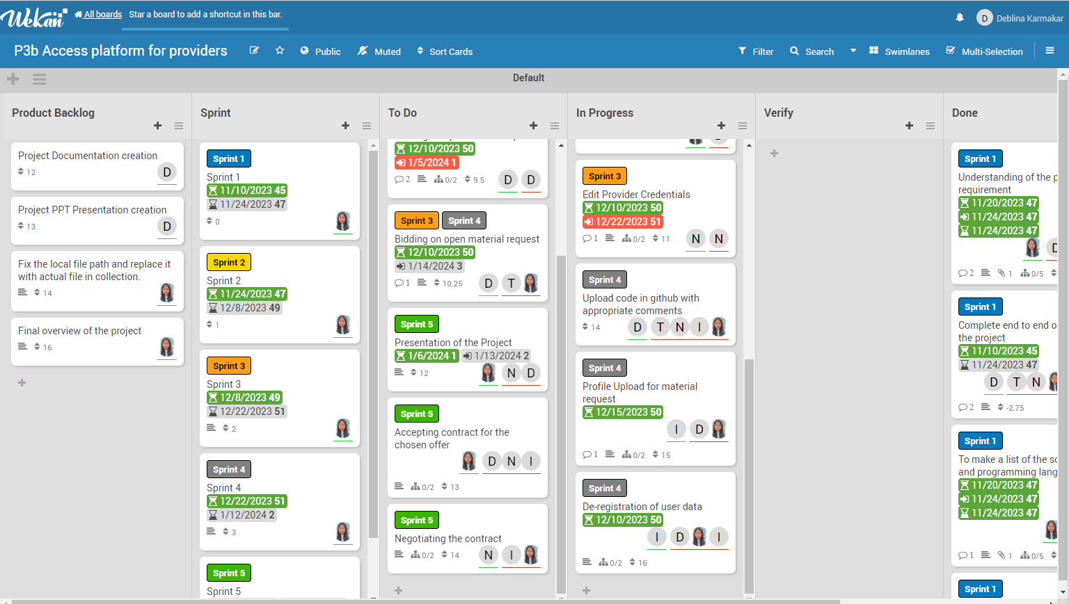
Kanban Board Visual

Slide 8
Requirements
User can login using authentication component
Provider Admin wants to edit provider credentials
Provider Admin wants to configure user management for provider (register new user, deregister user)
User wants to see the offers of the company “future-X” regarding master agreement types (example: technology-based)
User wants to provide an offer to establish a master agreement
User wants to bid on open service requests and material request
User wants to upload profiles of employees for service requests and responses to material requests
User wants to make suggestions based on the knowledge of each offered employee
User accepts contract if his offer has been chosen. Negotiation can take place
Further specification takes place during collaboration with the customer
APIs need to be provided to other groups

Slide 9
First Use Case Diagram
Registration
Login
Bid Active Master Agreement
APP
Edit Profile Info
Accept/Reject Master Agreement
Provide Salary
Access Master Agreement
9

Slide 10
Second Use Case Diagram
Access Open Services
Provider
Add Employees
Negotiate & Offer Employees
Logout

Slide 11
Workflow
Phase 2
Open Service request created and published from group 4b
Phase 1
Master Agreement created and published from group 2b
API consumed by group 3b and rendered
API consumed by group 3b and rendered
User selects open service request to offer employee
User accepts or reject the master agreement
User selects suitable employee
User able to view all accepted master agreement
No Bid for rejected master agreements
User provides offers with suitable salary
User able to bid on the master agreement

Slide 12
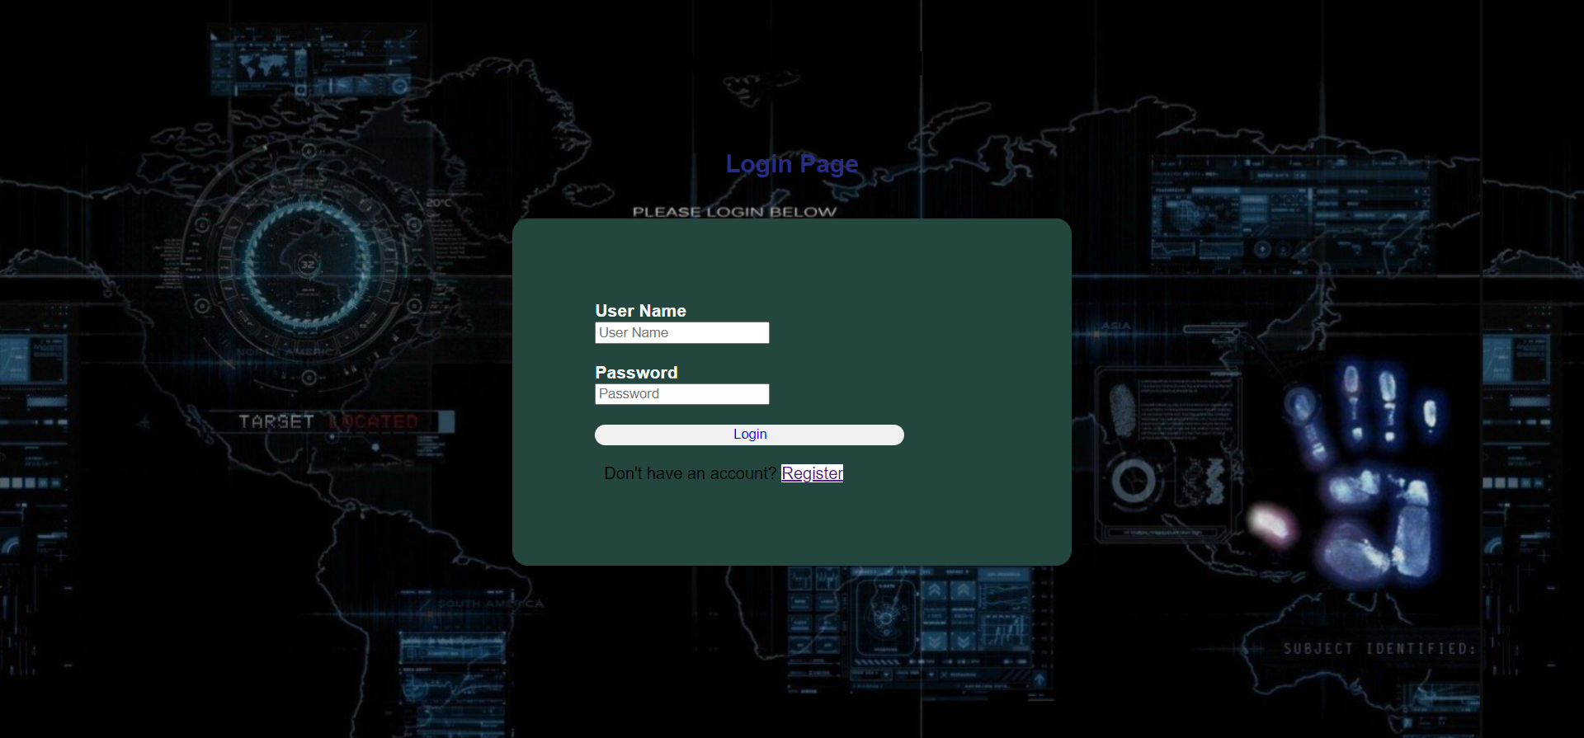

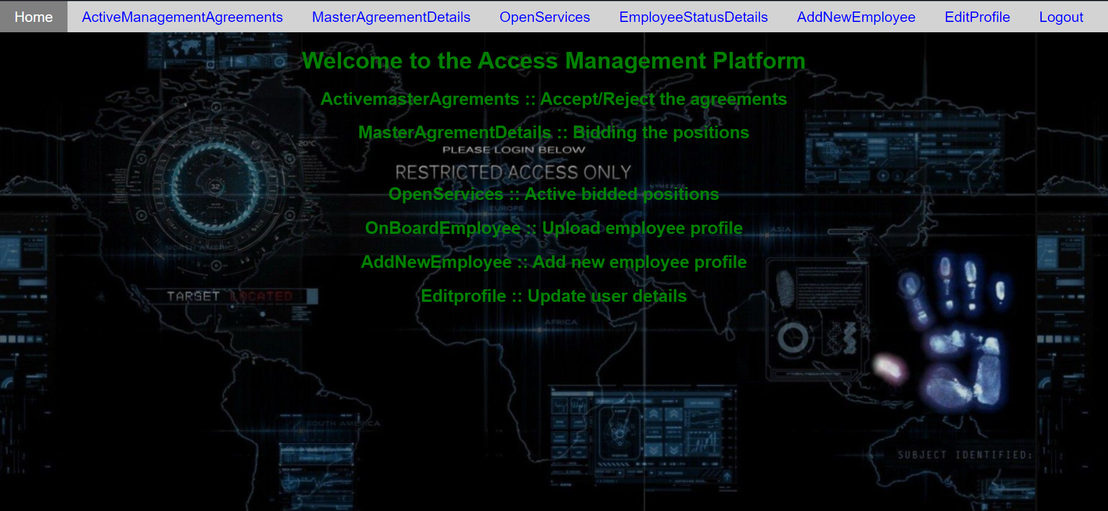
Output Screen (Login page and Home page)

Slide 13
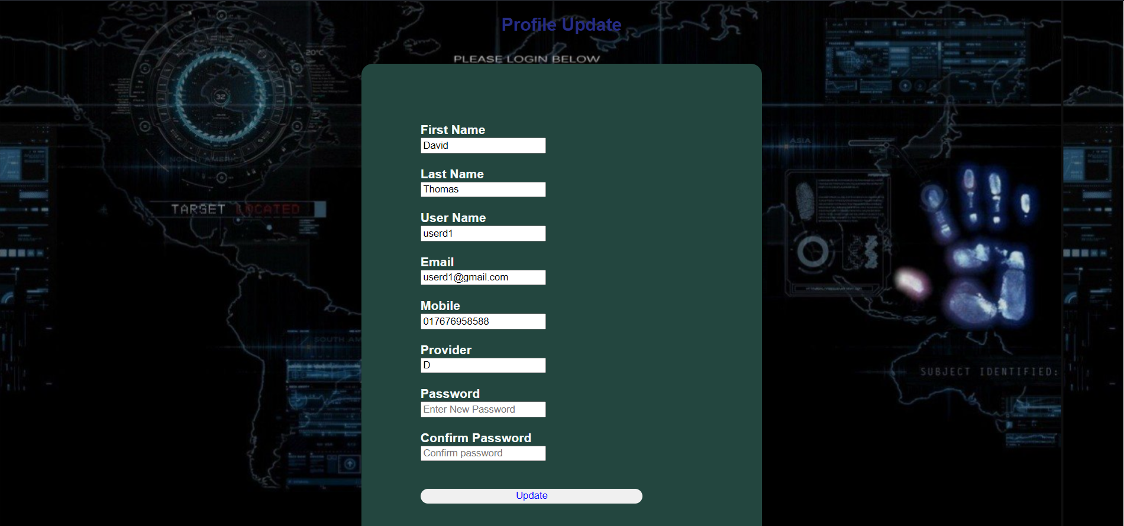
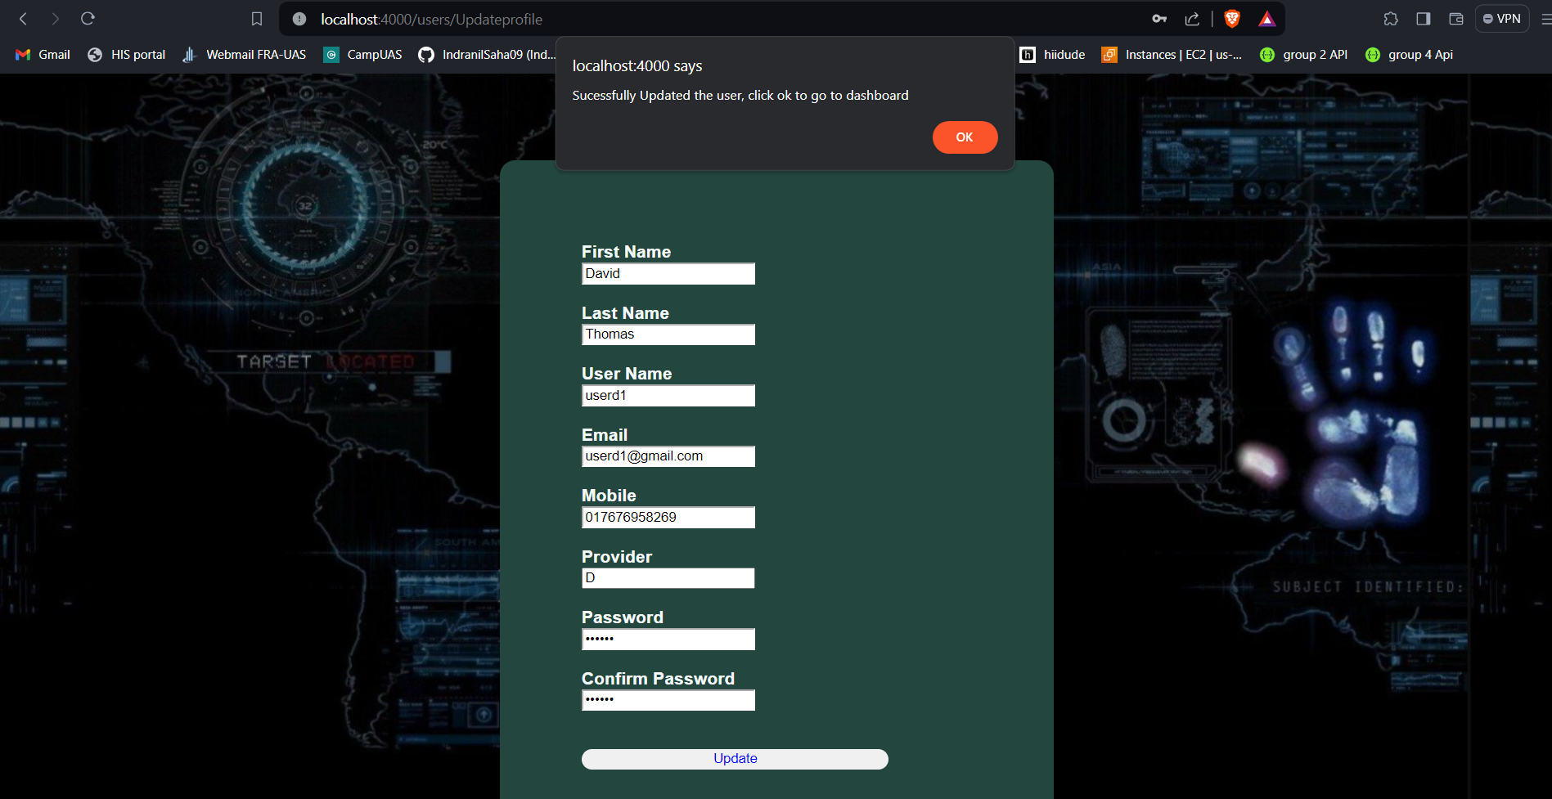
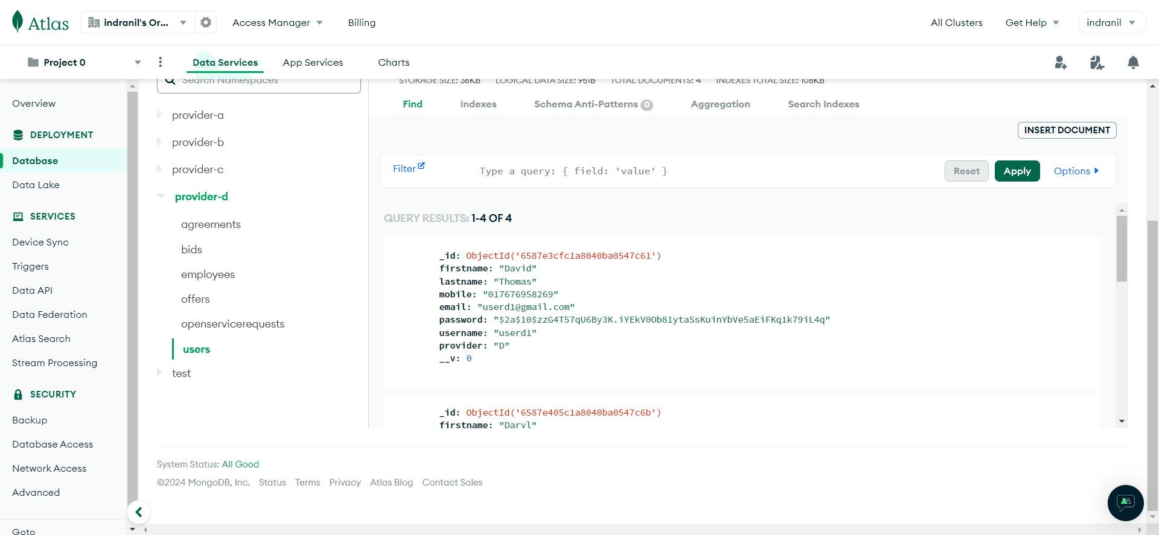
Output Screen(User Profile update)

Slide 14
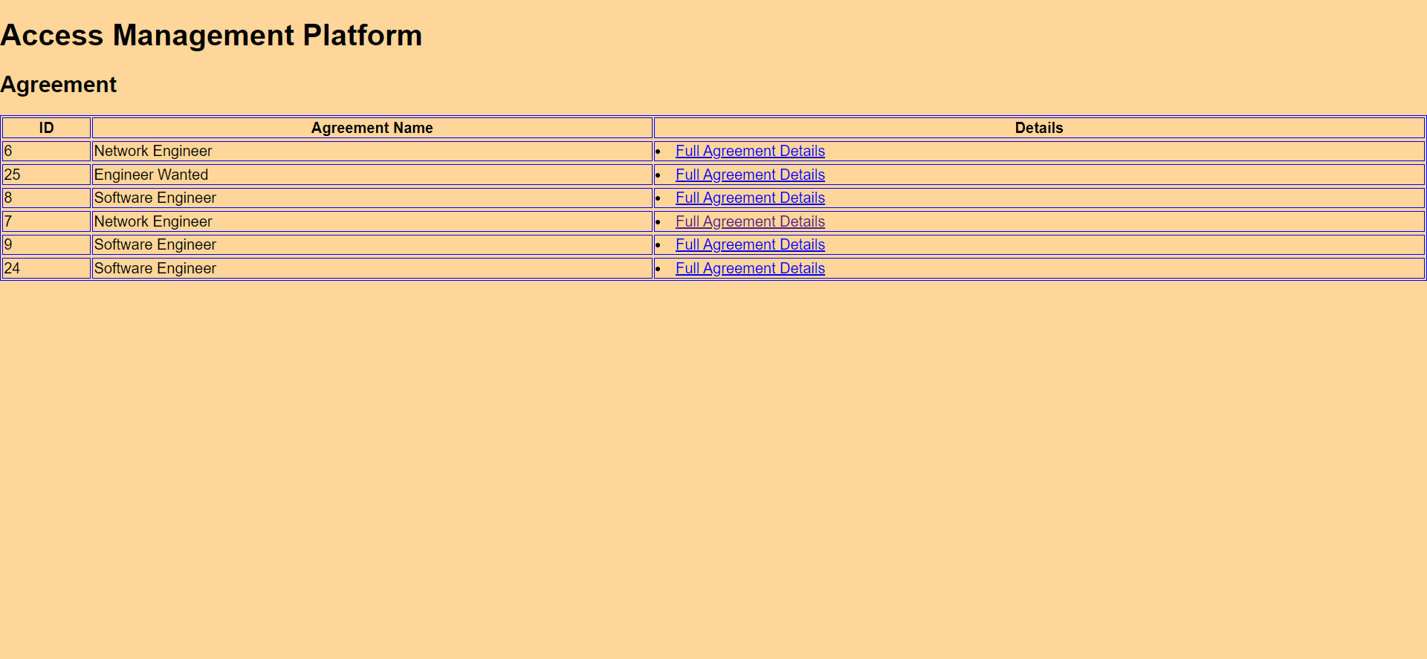
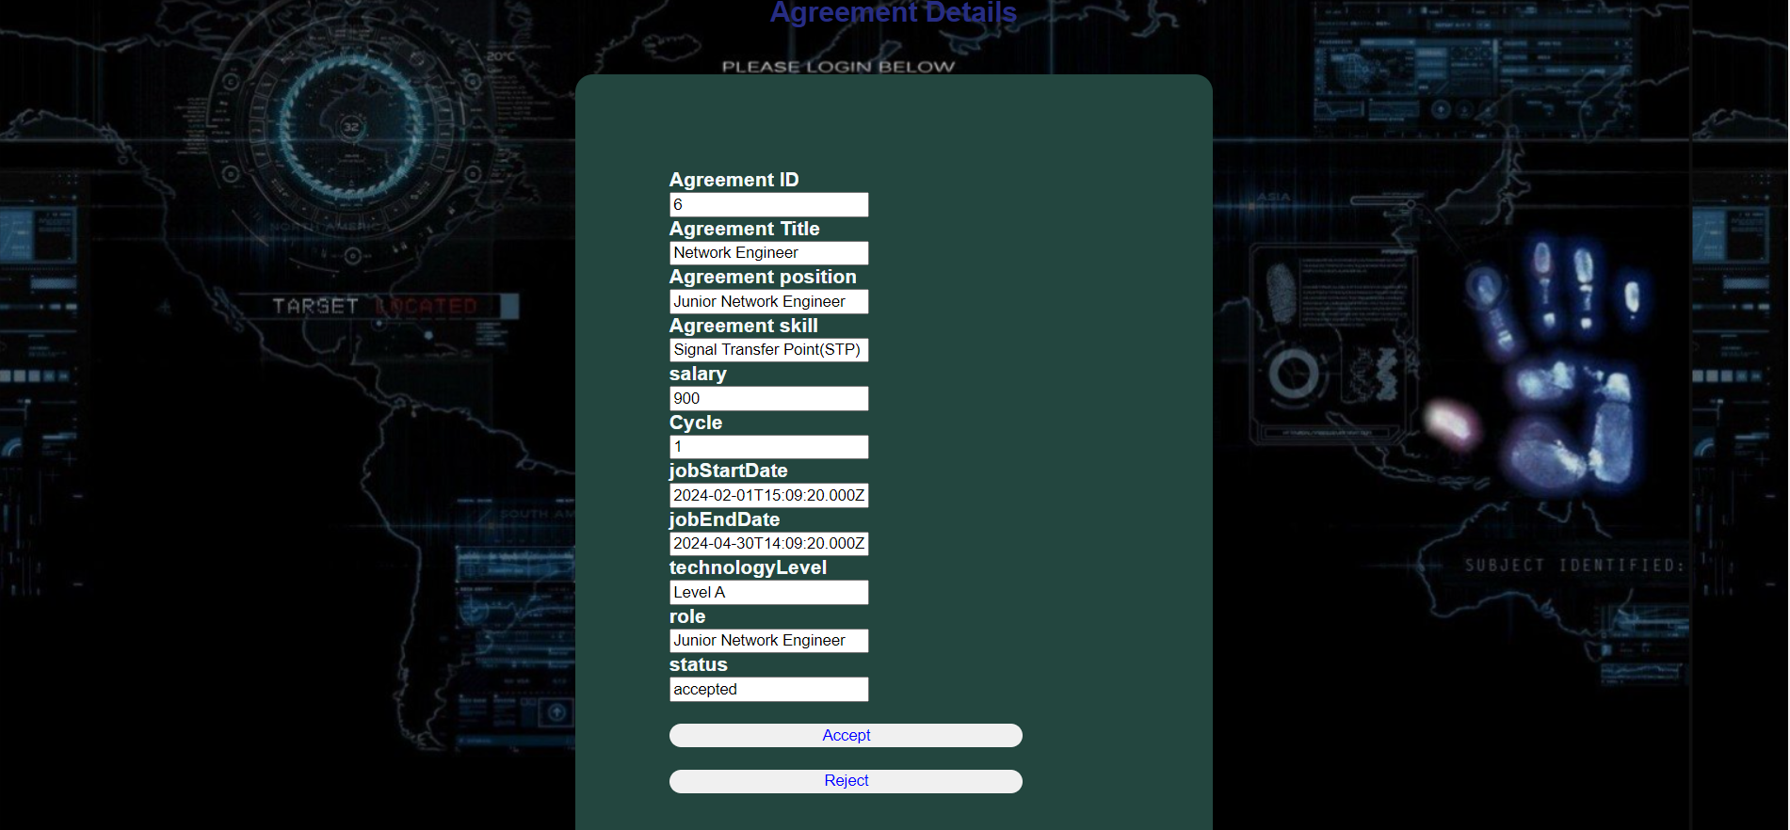
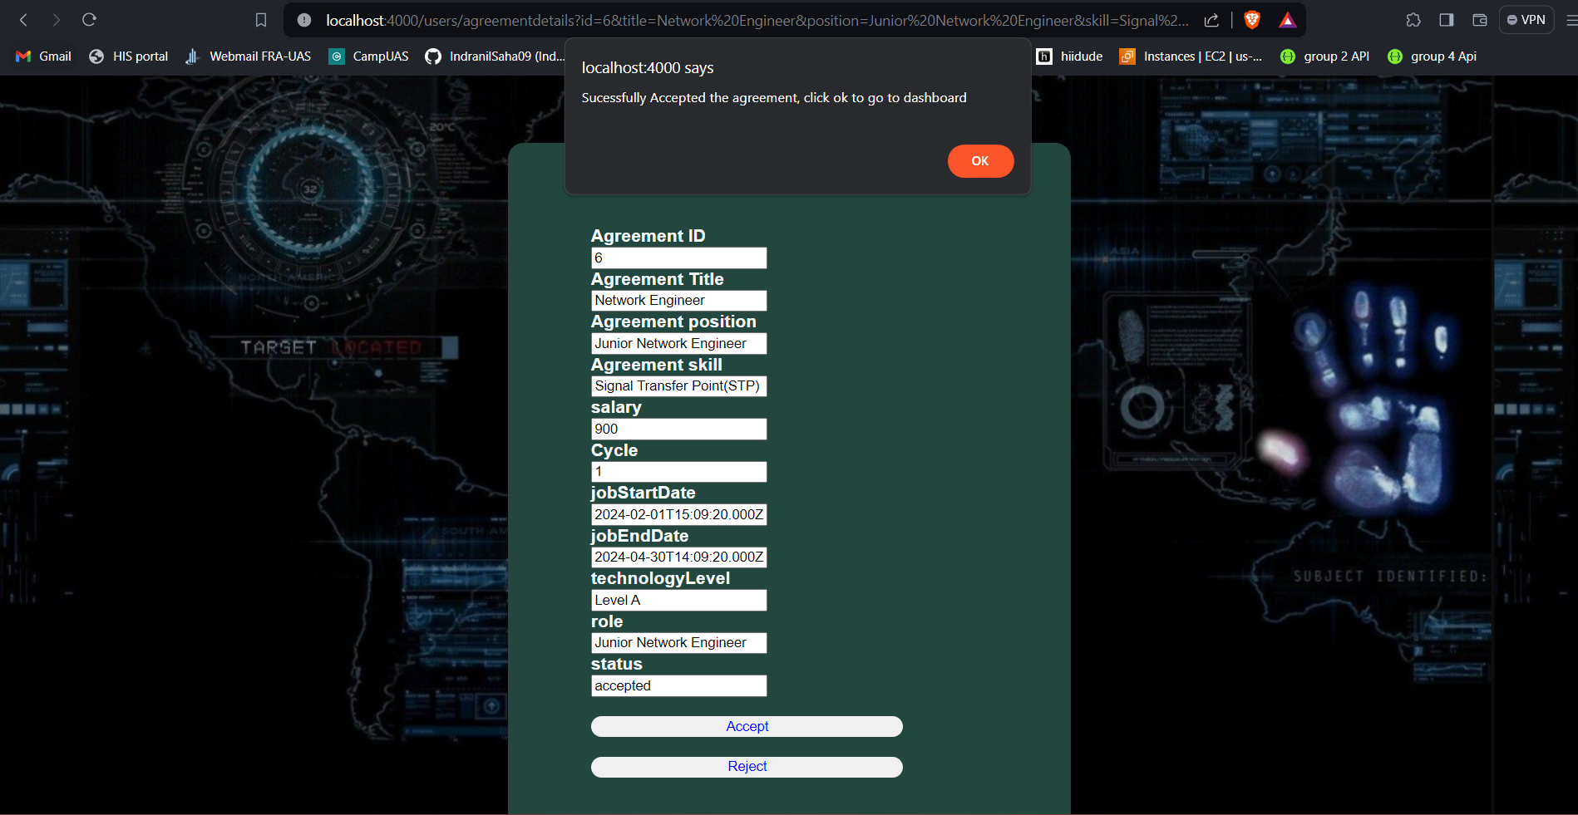
Output Screen (Master agreement and Details)

Slide 15
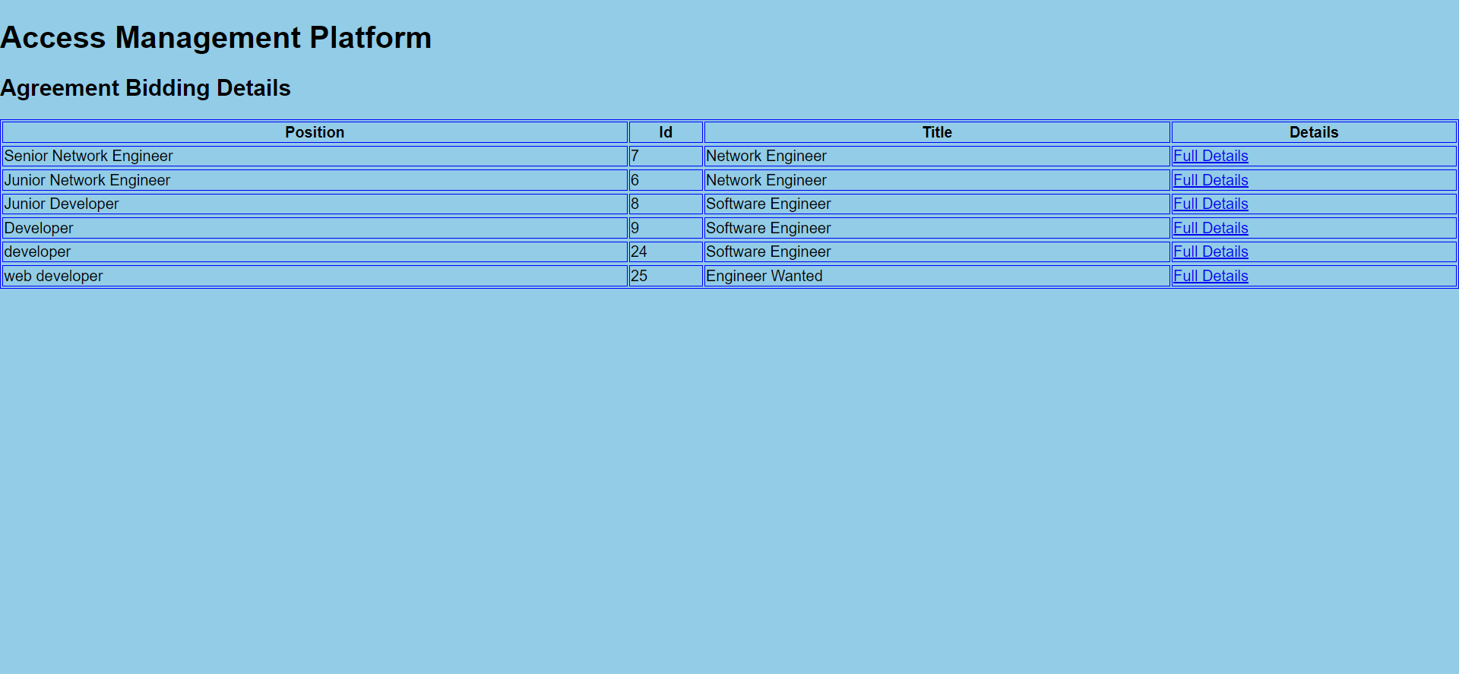
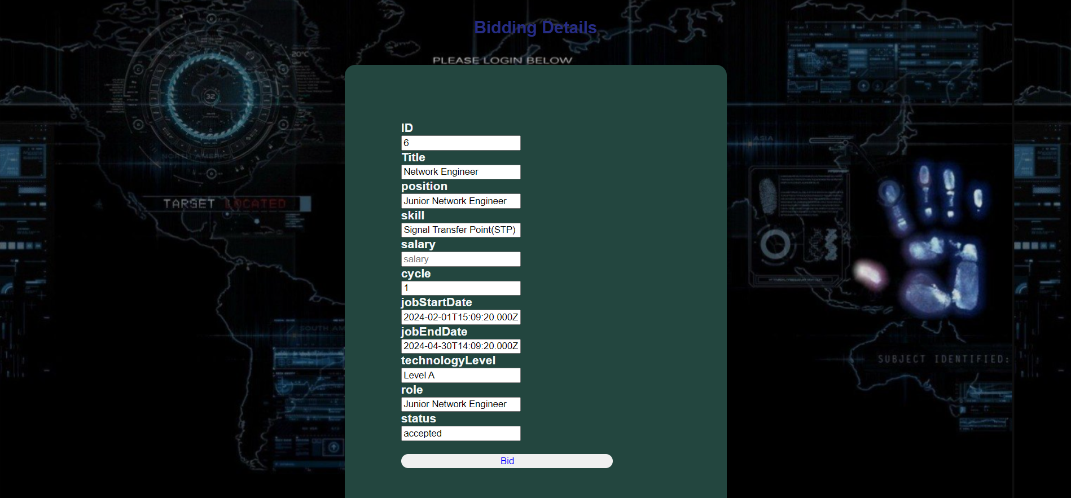
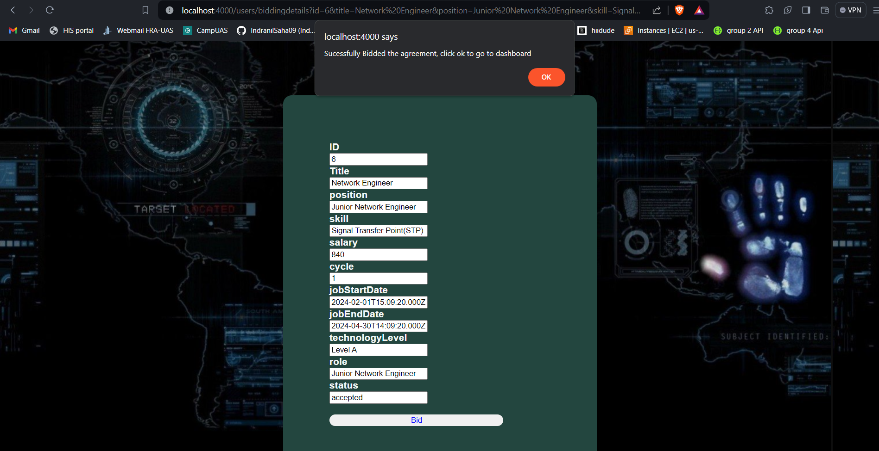
Output Screen(Master agreement bidding and details)

Slide 16
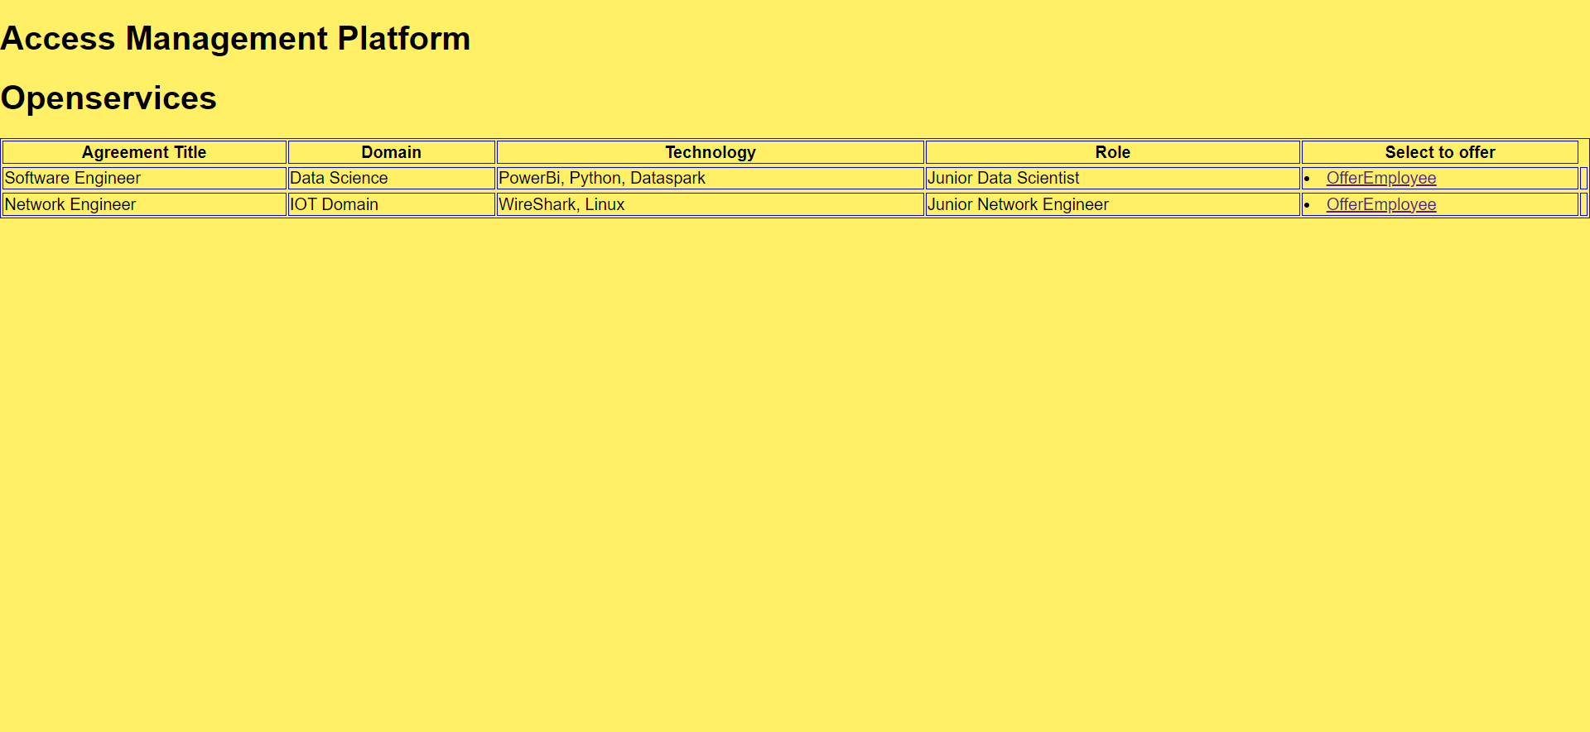
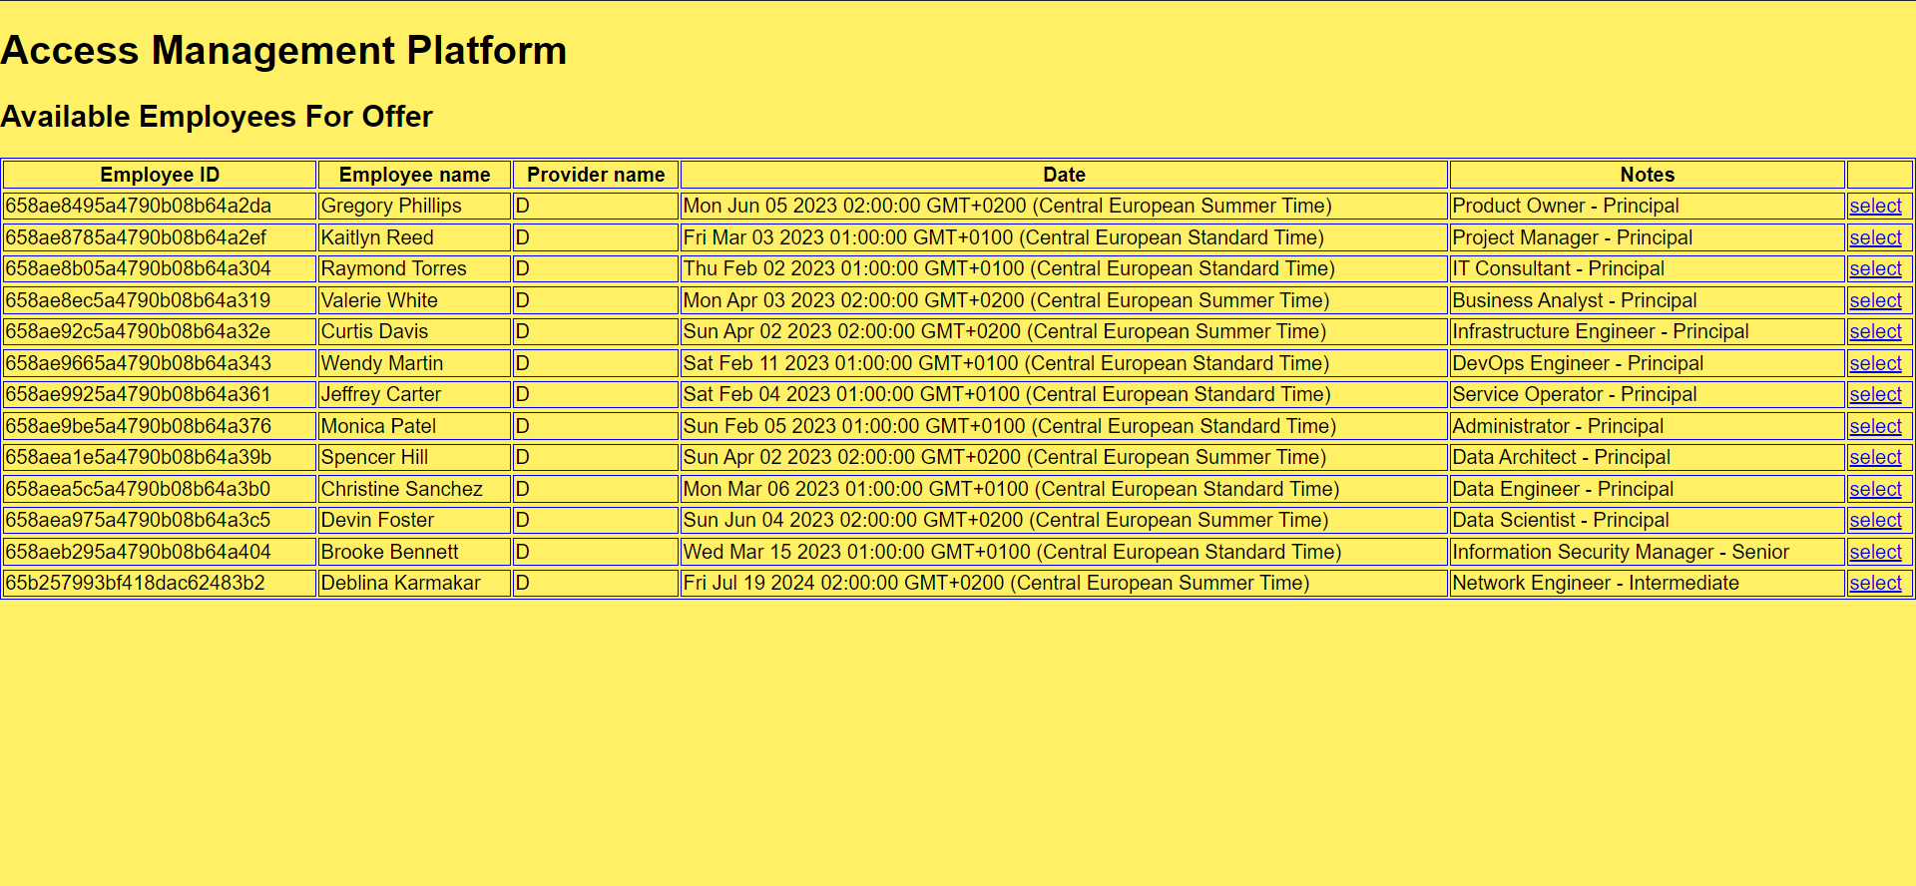
Output Screen(Open services & available employees)

Slide 17
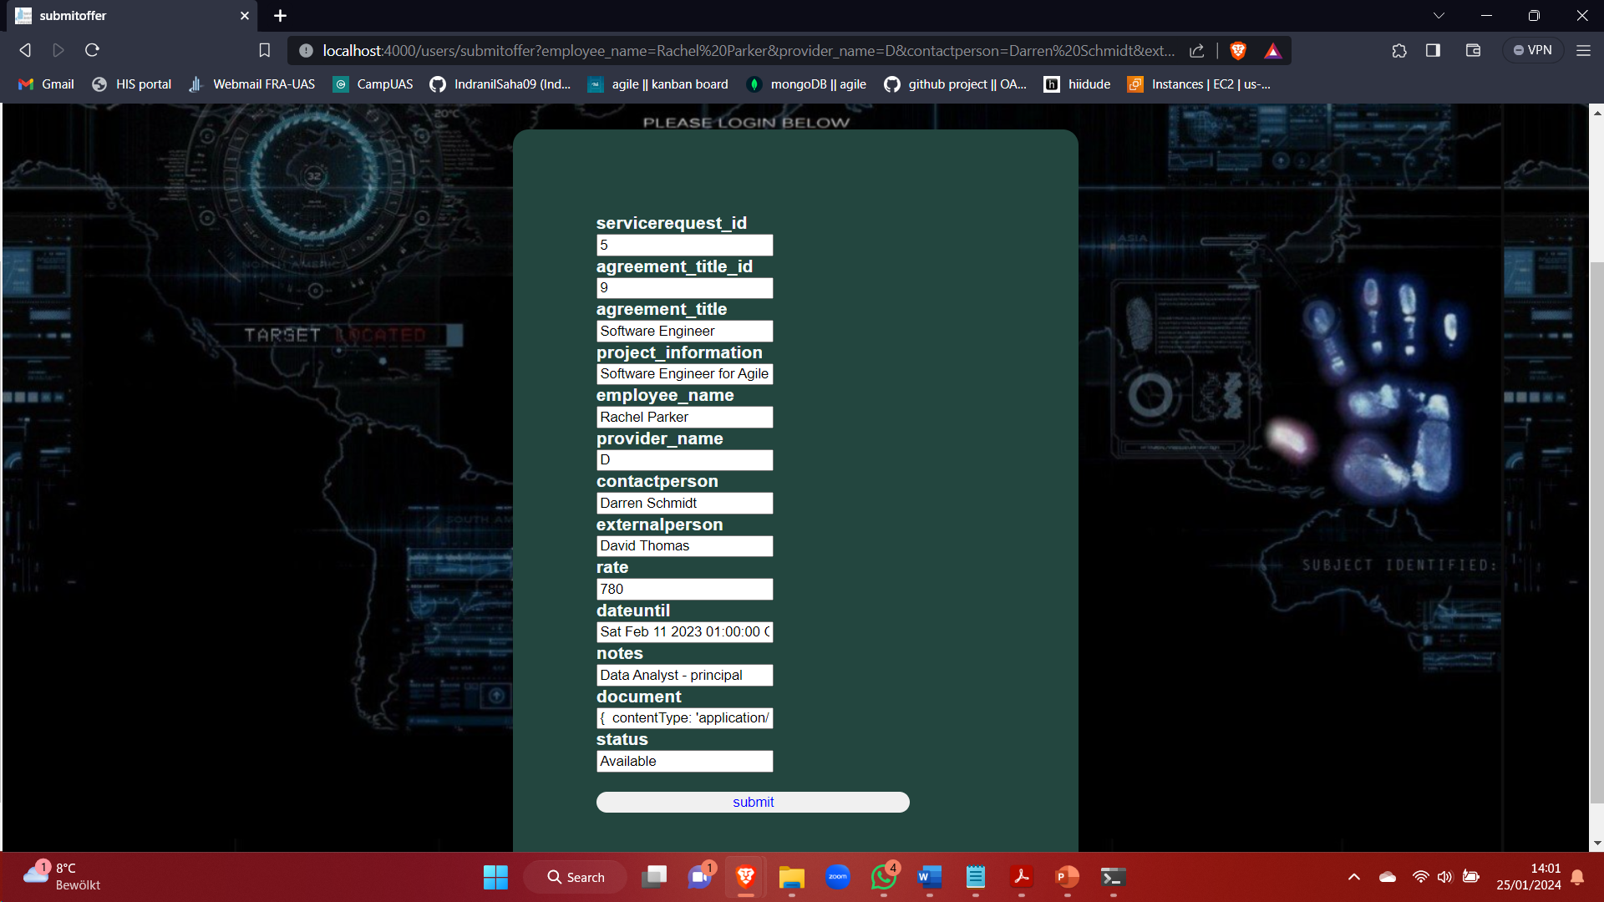
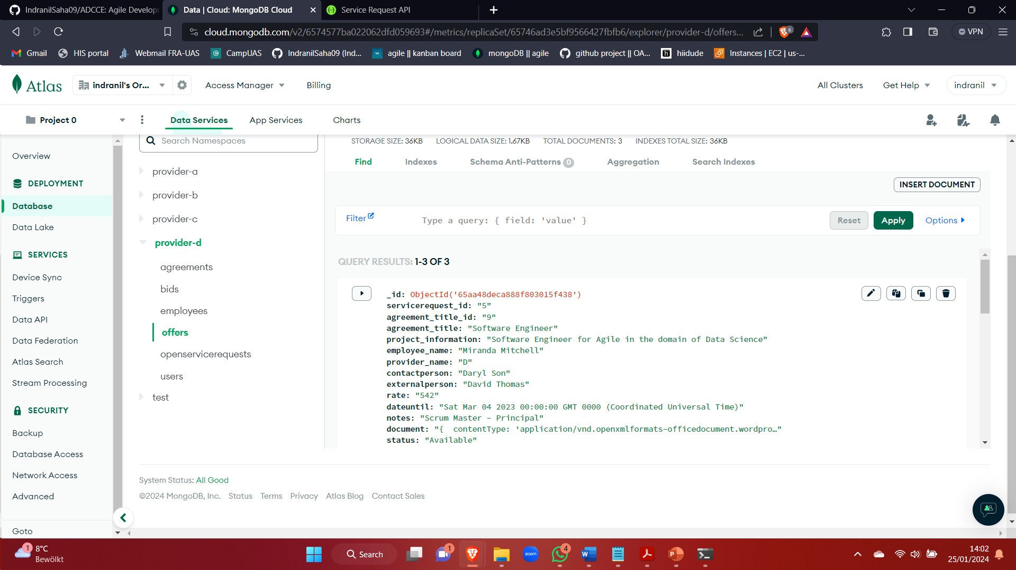
Output Screen (Employees offer and Database entries)

Slide 18
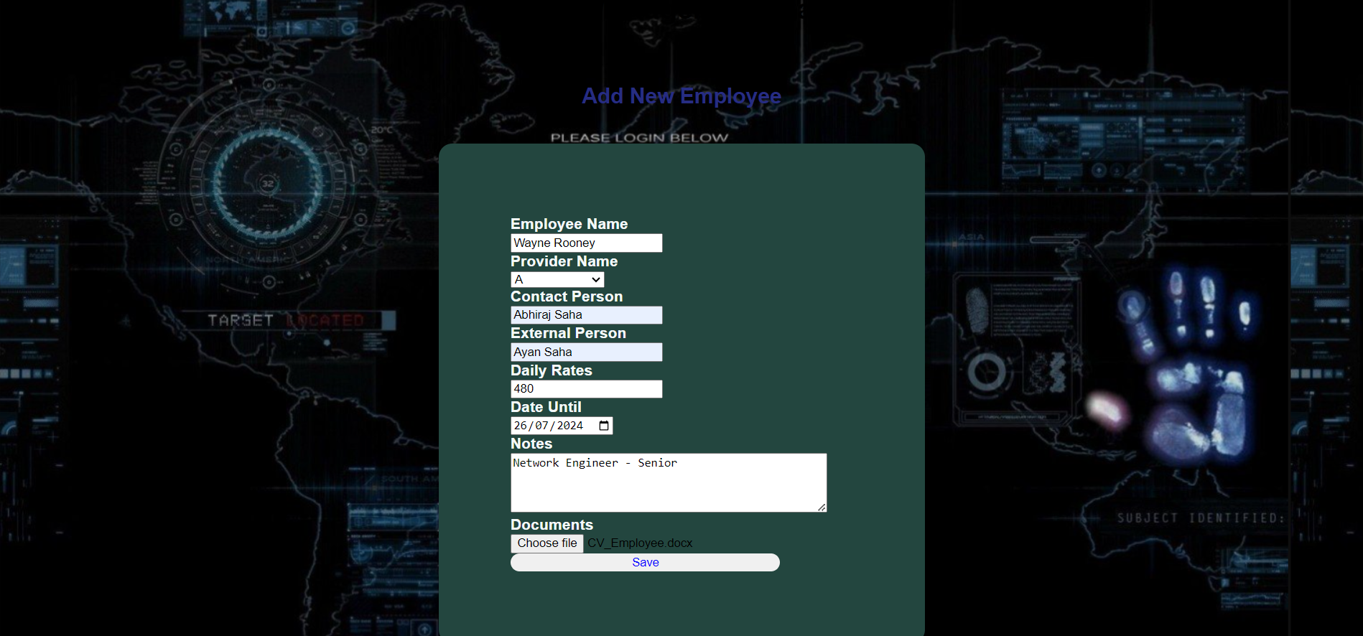
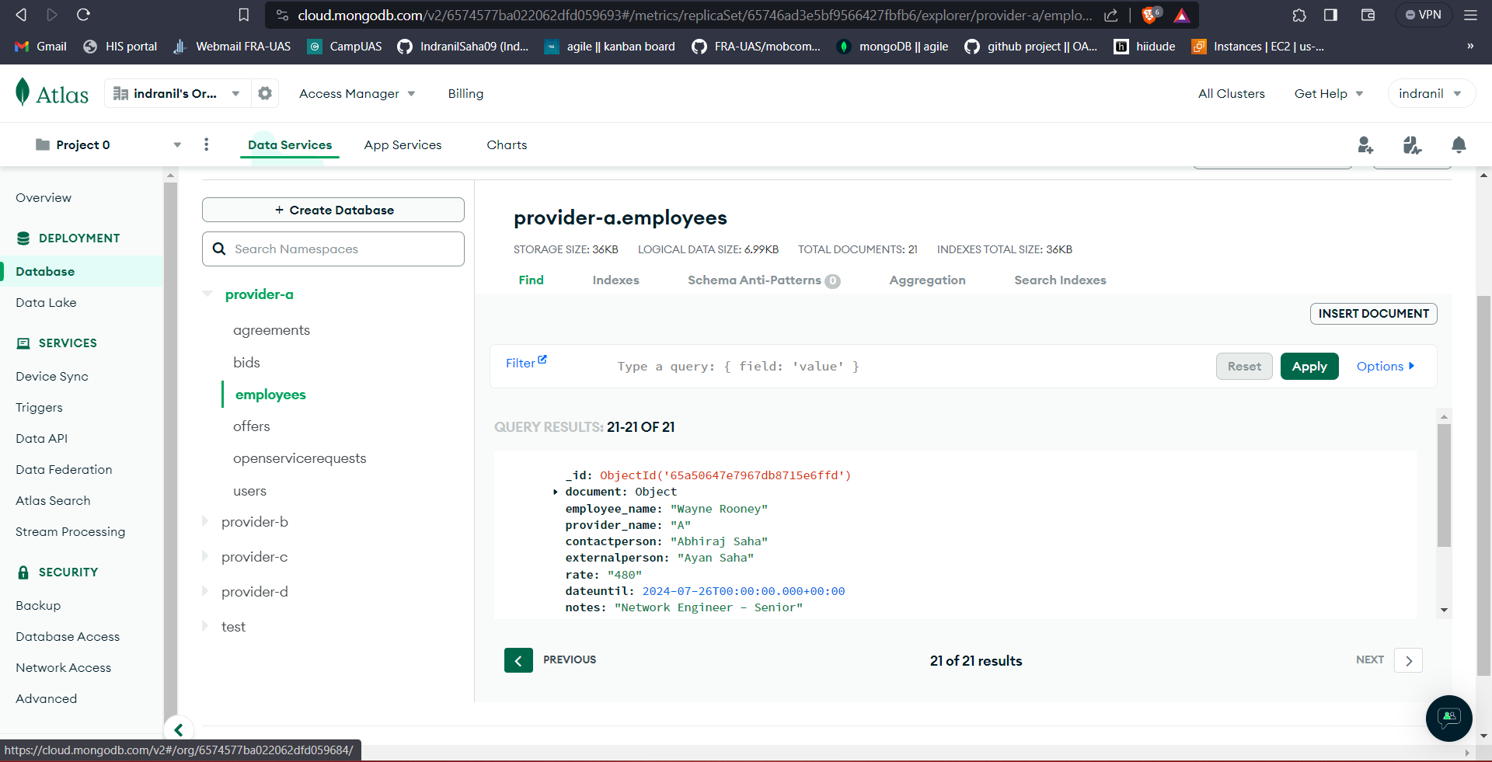
Output Screen(Add new employees)

Slide 19
Conclusion
Adoption of agile and scrum methodologies provides for an efficient and adaptable development approach.
Use of scrum framework is pivotal to provide a structured environment with iterative cycles for prompt incorporation of user feedback.
Streamline provider interaction with the master agreement and create a seamless platform for offer to service requests.

Slide 20
Thank You

